Slide 1

Positron annihilation spectroscopy in materials structure studies
Supervisor:
Siemek Krzysztof Ph.D.
(Dzhelepov Laboratory of Nuclear Problems)
Aleksandra Baszak
(Wrocław University of Science and Technology)
Ondřej Urban
(University of West Bohemia)

Slide 2
Content
Aim of the project
Sample preparation
Measurements using Doppler Broadening PAS
Calculations of anihilation parameters
Measurements using Lifetime PAS
Conclusion

Slide 3
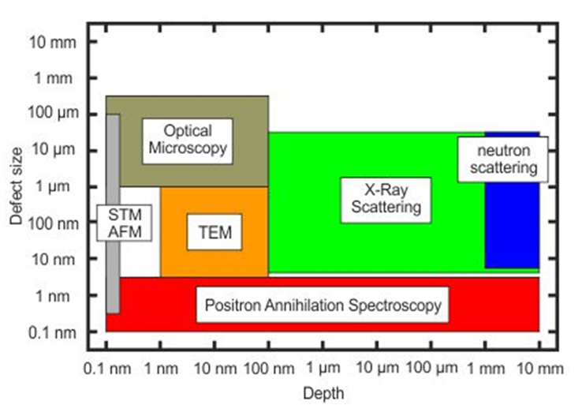
Aim of this project
Investigation of defects in cobalt lattice
Comparison of the results of theoretical calculations with measurements
HZDR-WebCMS, „HZDR,“ 9 11 2018. [Online]. Available: https://www.hzdr.de/db/Cms?pNid=3581

Slide 4
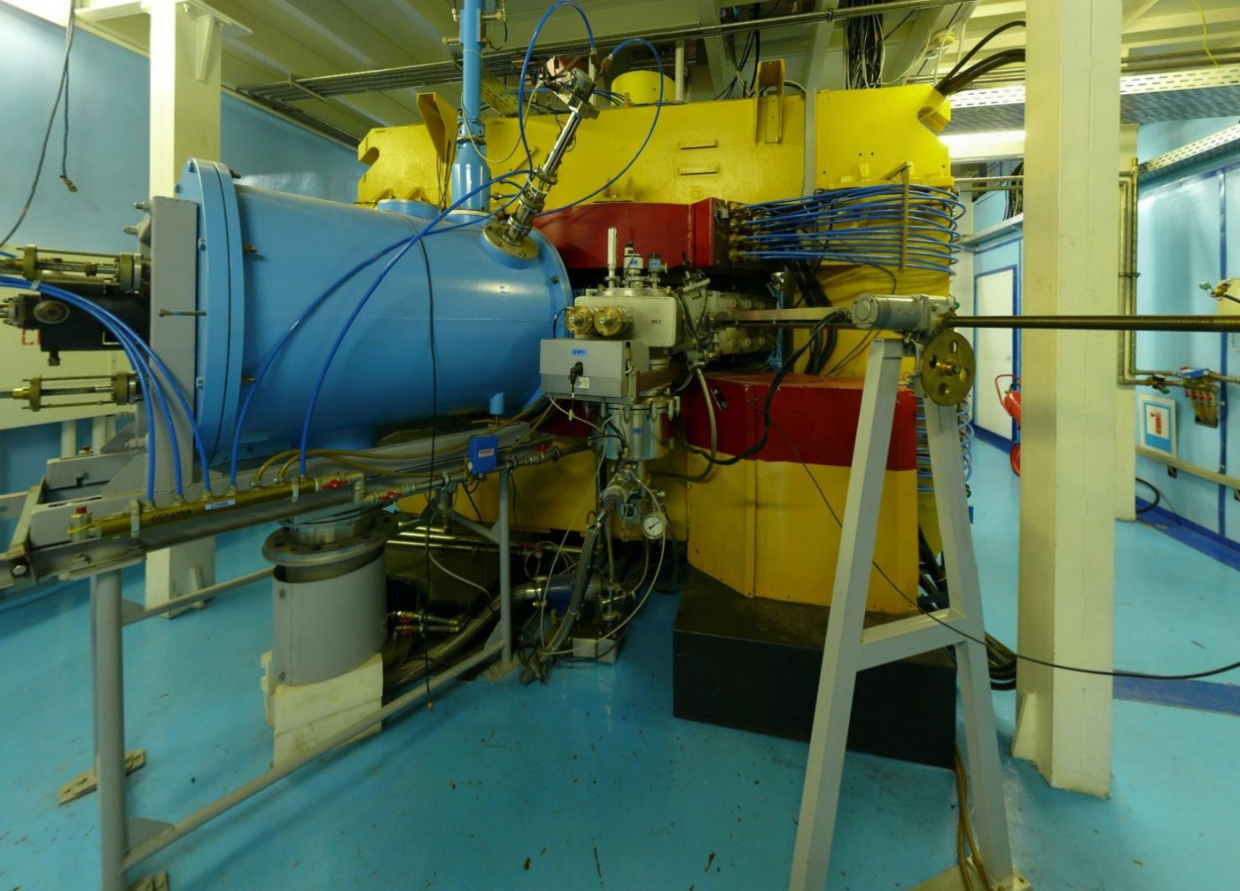
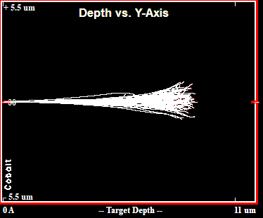
Sample preparation and SRIM simulation
Xe ions of 167 MeV energy have been implanted using the IC-100 cyclotron into Co sample
http://flerovlab.jinr.ru/flnr/ic-100.html

Slide 5
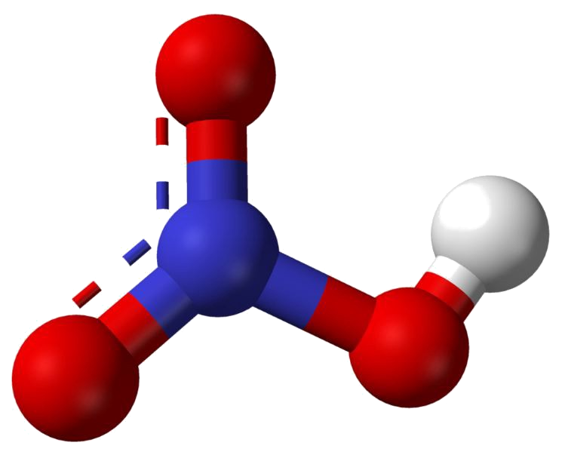
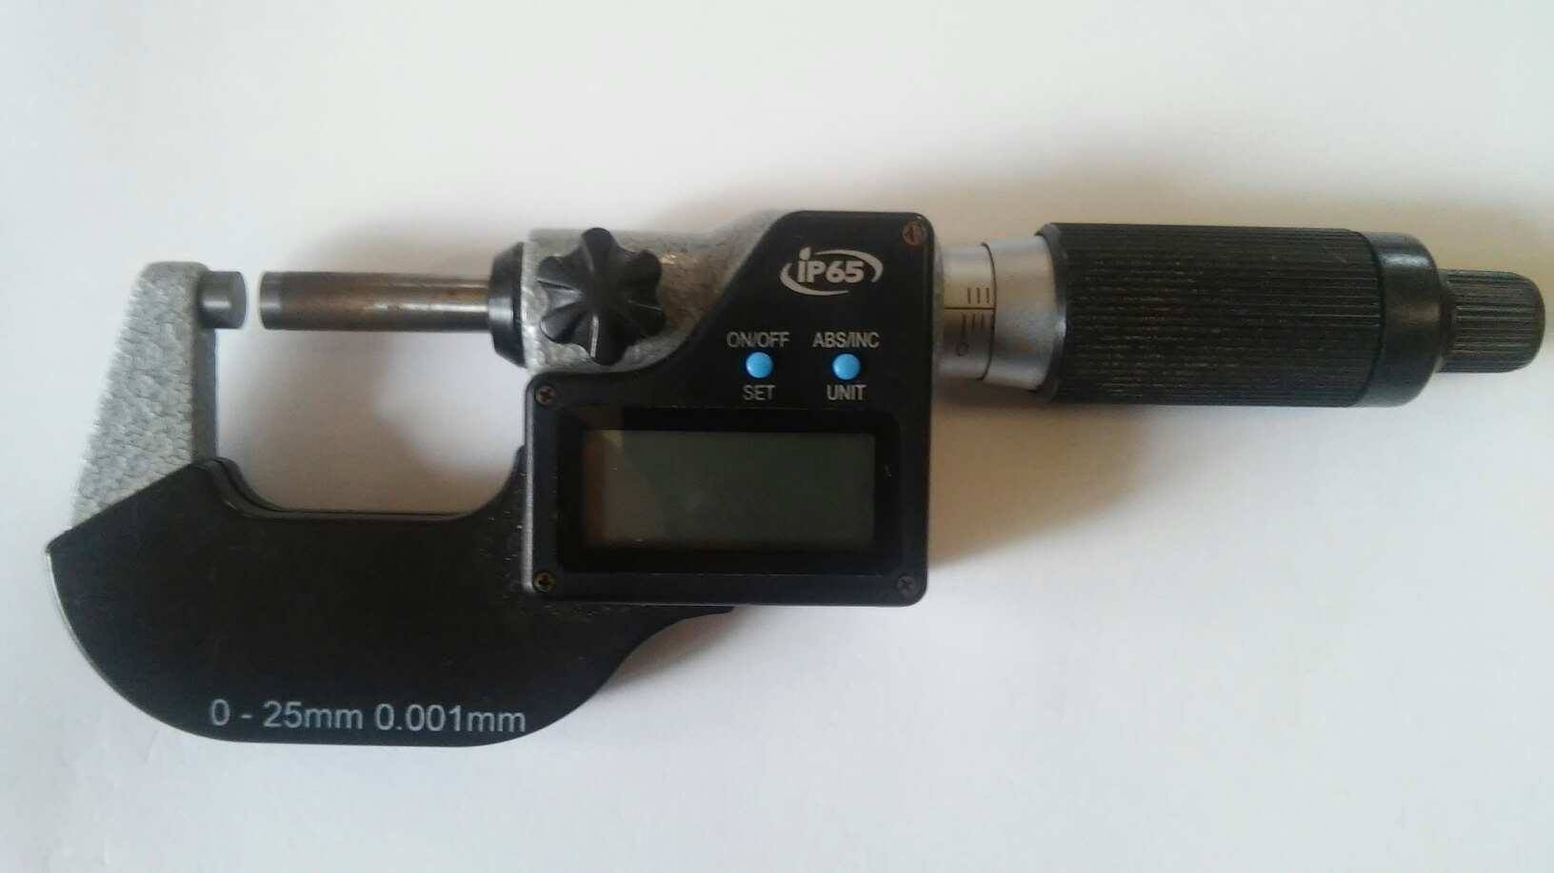

Etching of the sample
Measurement of the sample
Immersion of the sample in acid
Rinsing the sample in water
Next measurement
$HNO_{3}+HCl$
The removed subsurface layer in one step had
2 μm.
„Manufacturing of nitric acid by Ostwald proces” https://medium.com/@worldofchemical/manufacturing-of-nitric-acid-by-ostwald-process-3c974e361ed0

Slide 6
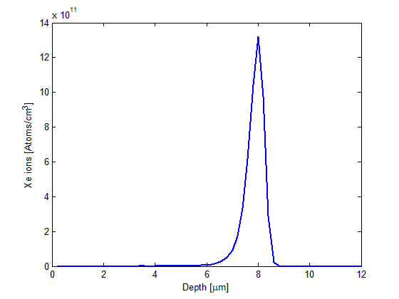
Defects created by xenon ions

Slide 7
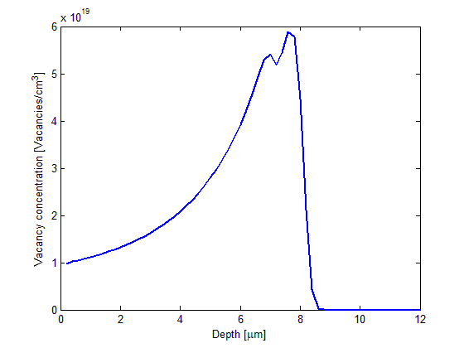
Distribution of vacancies

Slide 8
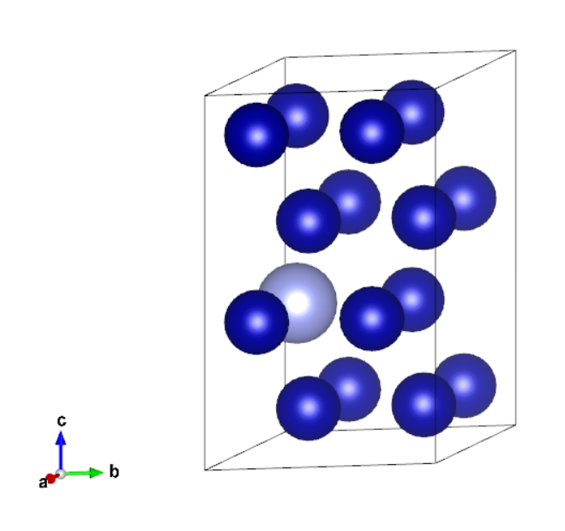
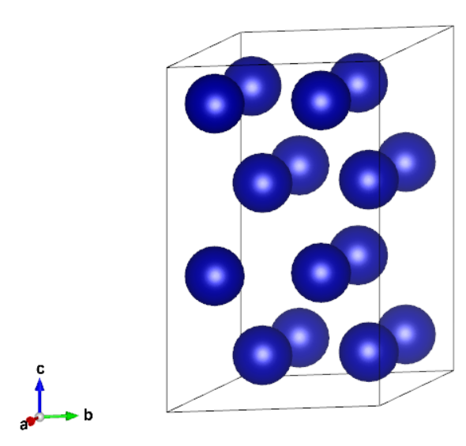
Lattice visualization

Slide 9
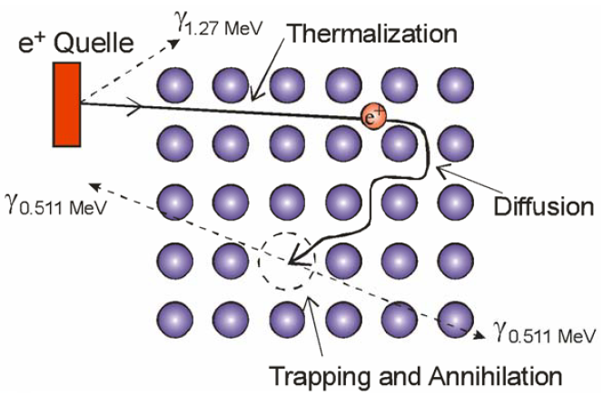
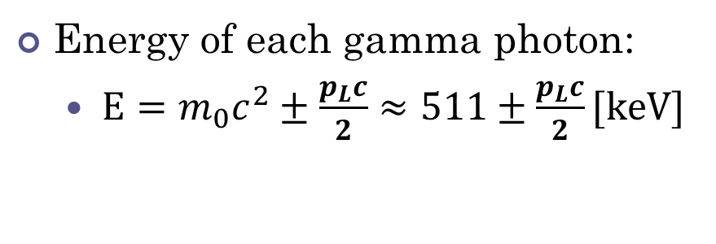
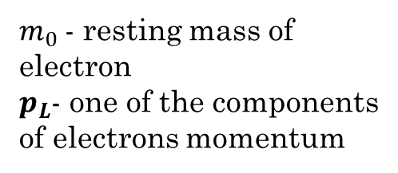
Doppler broadening positron annihilation spectroscopy
Energy of each gamma photon:
  $E={m_{0}c}^{2}±\frac{p_{L}c}{2}≈511±\frac{p_{L}c}{2}[keV]$
$m_{0}$- resting mass of electron
$p_{L}$- one of the components of electrons momentum
R. Krause-Rehberg, „Fundamentals of positron annihilation spectroscopy and and its application in semiconductors,“ Martin-Luther-University Halle-Wittenberg, Germany.

Slide 10
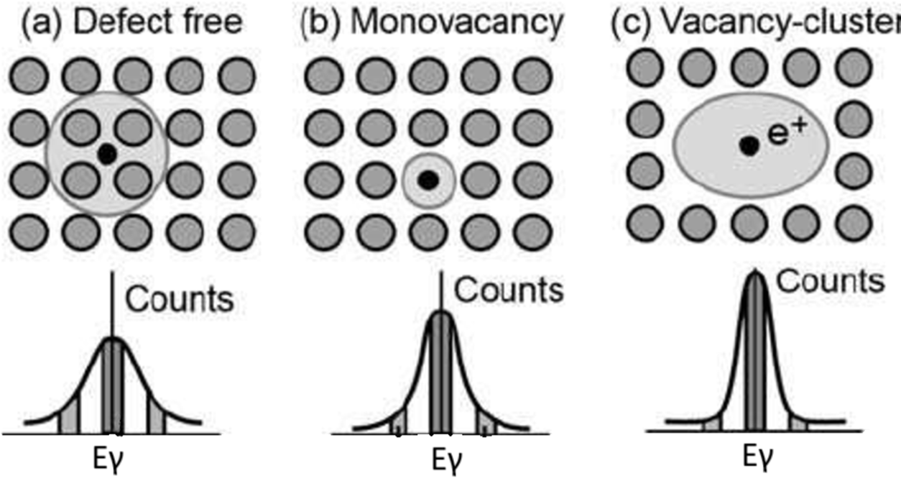
Doppler broadening positron annihilation spectroscopy
A. Uedono, S. Ishibashi, O. Nagayasu a R. Suzuki, „Point Defect Characterization of Group-III Nitrides by Using Monoenergetic Positron Beams,“ ECS Transactions, 2014

Slide 11
Doppler broadening positron annihilation spectroscopy
S and W parameters give us information about the defects
K. Siemek, „Positron studies of defects in materials,“ Dubna, Russia, 2019.

Slide 12
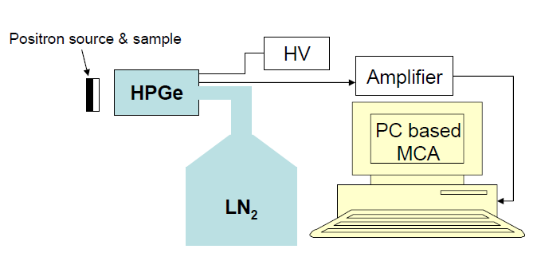
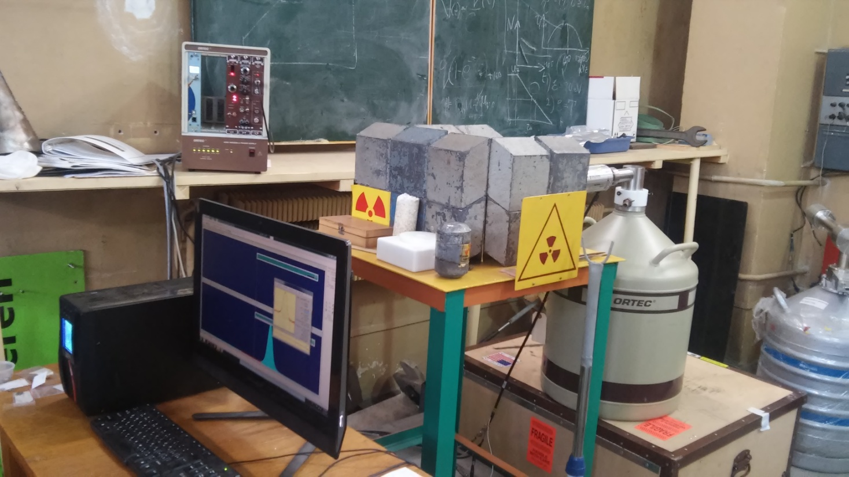
Measurement
S. Abhaya, G. Amarendra, „Doppler broadening spectroscopy,“ Kolkata, 2009.

Slide 13
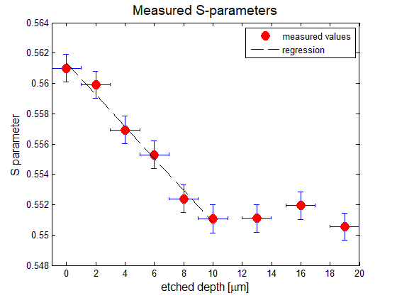
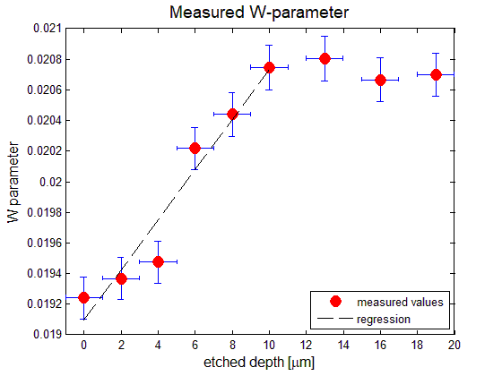
Results
Positrons are implanted at the average depth of 20 μm.

Slide 14
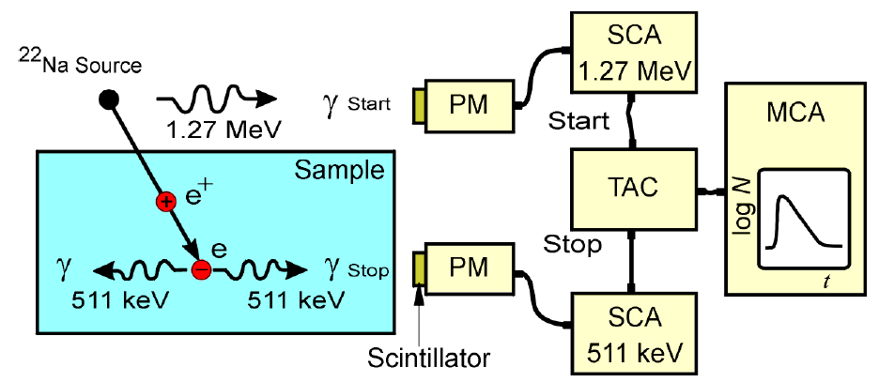
Positron Annihilation Lifetime Spectroscopy
Lifetime of positron inside the samples is measured
R. Krause-Rehberg, „Fundamentals of positron annihilation spectroscopy and and its application in semiconductors,“ Martin-Luther-University Halle-Wittenberg, Germany

Slide 15

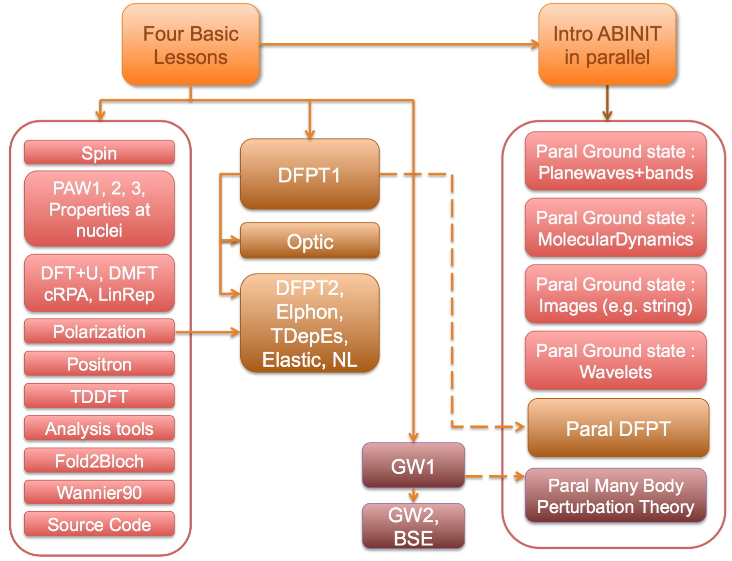
„ABINIT is a package whose main program allows one to find the total energy, charge density and electronic structure of systems made of electrons and nuclei (molecules and periodic solids) within Density Functional Theory (DFT), using pseudopotentials (or PAW atomic data) and a planewave basis.”
www.abinit.org

Slide 16
Results of Abinit calculations
꙳ J M Campillo Robles et al 2007 J. Phys.: Condens. Matter 19 176222, „Positron lifetime calculation for the elements of the periodic table”

Slide 17
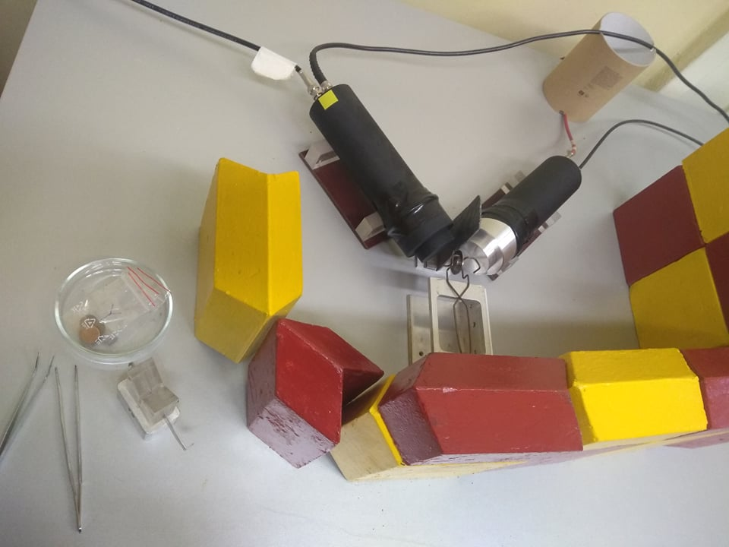
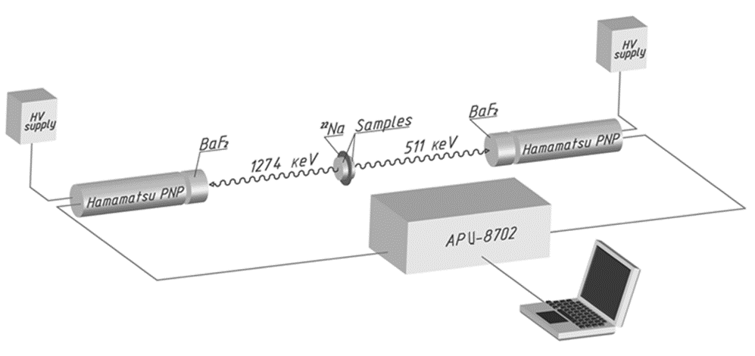
Measurement

Slide 18
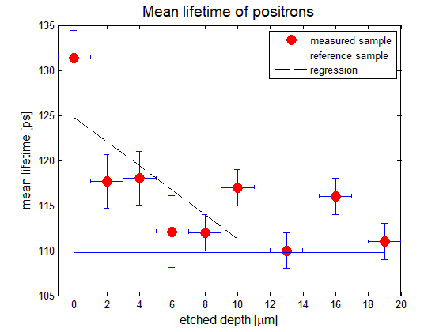
Results

Slide 19
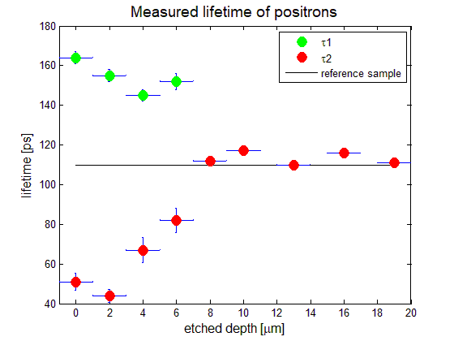
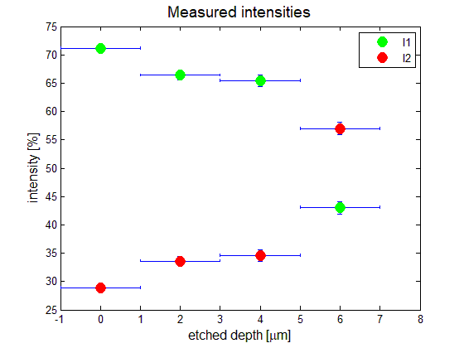
Results

Slide 20
Conclusion
Irradiated Cobalt sample has been examined using both Lifetime and Doppler Broadening Positron Annihilation Spectroscopy.
From theoretical calculations and measurements, we can conclude that in the tested sample we can find mainly single and double vacancies .
The depth of penetration of Xenon ions simulated by the SRIM program agrees with the measured by both metods and equals 8 microns.
No significant defects have been detected above
depth of 8 microns.

Slide 21

Thank you for attention
Any questions?

